Slide 1

Blockchain
Sunitha R
Department of Computer Science and Engineering

Slide 2

Blockchain
DNS
Sunitha R
Department of Computer Science and Engineering

Slide 3
Blockchain
DNS records
DNS records are mapping files that associate with DNS server whichever IP addresses each domain is associated with, and they handle requests sent to each domain.
MX records: These records identify the servers that can exchange emails. A priority is always associated with each of the records, so the user can choose the primary and backup mail servers.
TXT records: These records deliver a method to expand the information provided through DNS. This text record stores information about the SPF that can identify the authorized server to send email on behalf of your organization.

Slide 4
Blockchain
DNS records
CNAME: CNAMEs are essentially domain and subdomain text aliases to bind traffic. They indicate that the Secure File Transfer Protocol (SFTP) server is on the same system as the mail server. CNAME plays an important role, particularly when the server is not under organizational control such as a hosted or managed web server.
PTR records: These records provide the reverse binding from addresses to names. PTR records should exactly match the forward maps.

Slide 5
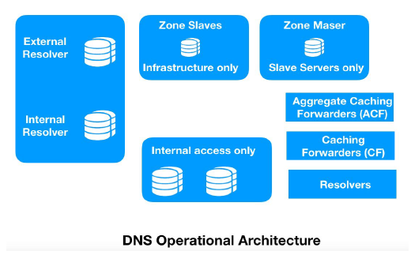
Blockchain
DNS Architecture

Slide 6
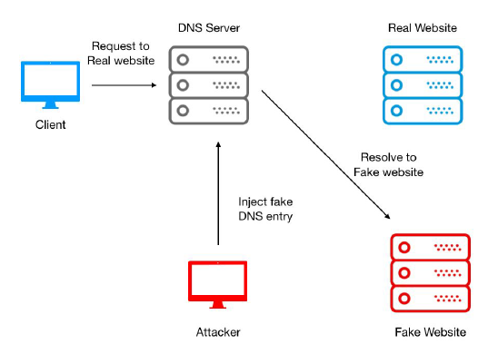
Blockchain
Challenges with current DNS

Slide 7
Blockchain
DNS spoofing
DNS cache poisoning: An attacker can take advantage of cached DNS records and can then perform spoofing by injecting a forged DNS entry into the DNS server. As a result, all users will now be using that forged DNS entry until the time the DNS cache expires.
Compromising a DNS server: A DNS server is the heart of the entire DNS infrastructure. An attacker can use several attack vectors to compromise a DNS server and can provide the IP address of a malicious web server against each legitimate DNS query.
Man-in-the-middle (MITM) attack: In this type of attack, a threat actor keeps listening to conversations between clients and a DNS server. After gathering information and sequence parameters, it starts spoofing the client by pretending to be the actual DNS server and provides the IP addresses of malicious websites.

Slide 8
Blockchain
Blockchain-based DNS solution
DNSChain is one of the most active projects to transform the DNS framework and protect it from spoofing challenges.
DNSChain is a blockchain-based DNS software suite that replaces X.509 public key infrastructure (PKI) and delivers MITM proofs of authentication. It allows internet users to set a public DNSChain server for DNS queries and access that server with domains ending in .bit.
X.509 PKI replacement
X.509 is a standard framework that defines the format of PKI to identify users and entities over the internet.
MITM-proof DNS infrastructure
This uses a public key pinning technique to get rid of the MITM attack problem. Public key pinning specifies two pin-sha256 values; that is, it pins two public keys (one is the pin of any public key in the current certificate chain and the other is the pin of any public key not in the current certificate chain).

Slide 9
Blockchain
Supplementary readings
https://ieeexplore.ieee.org/document/8647279
https://www.researchgate.net/publication/339062224_A_Brief_Review_of_Blockchain-based_DNS_Systems

Slide 10
THANK YOU
Prof.Sunitha R
Department of Computer Science and Engineering
sunithar@pes.edu

